Slide 1


Welcome to the FIFA 2019
Let‘s do this!
Login
Register here

Slide 2

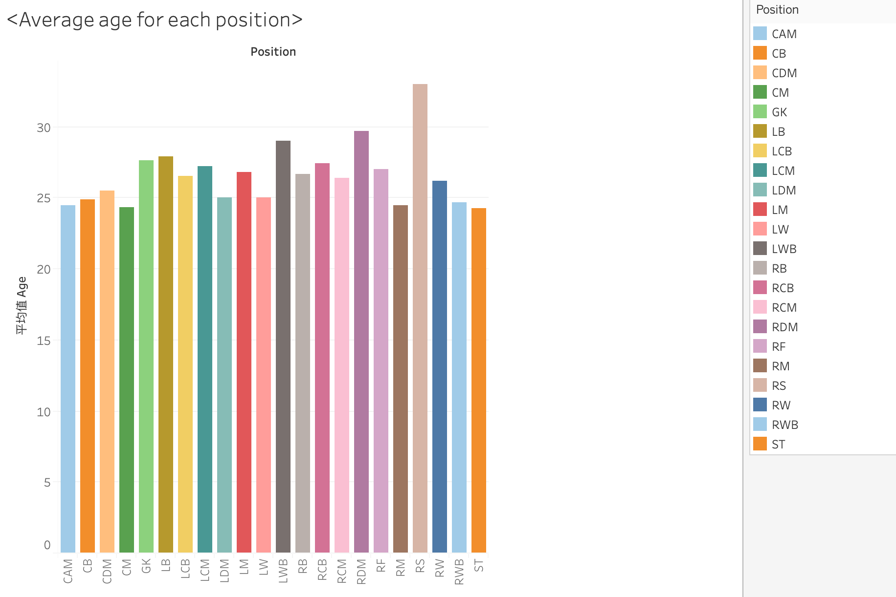
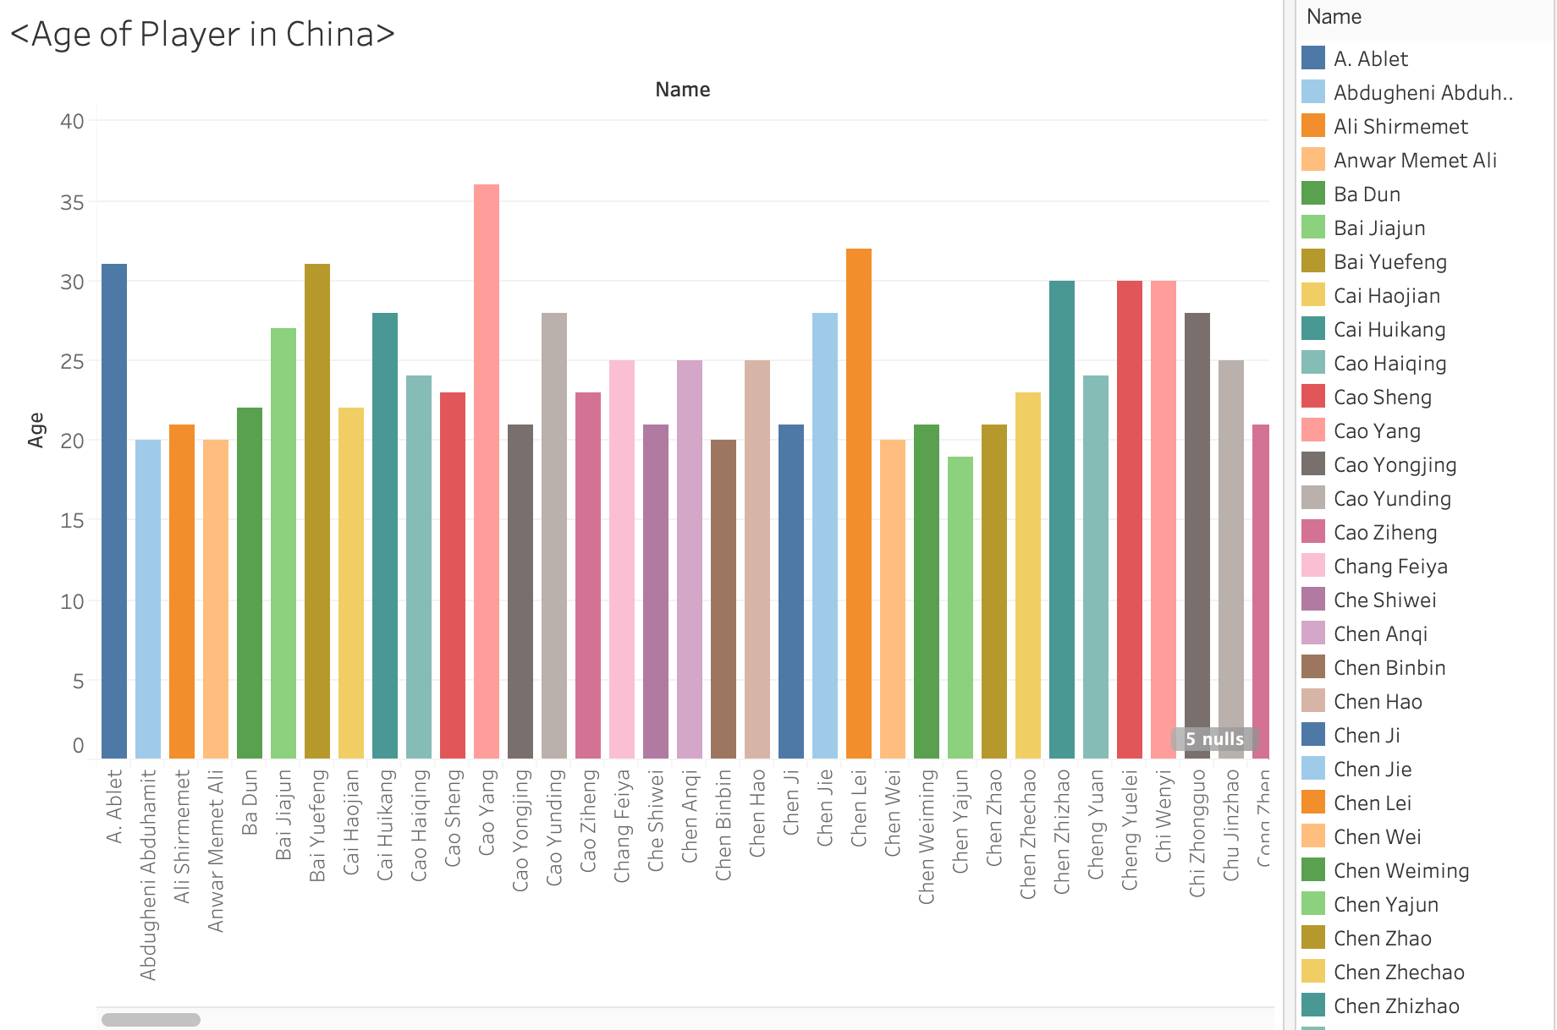
Data Interactive Visualization

Slide 3
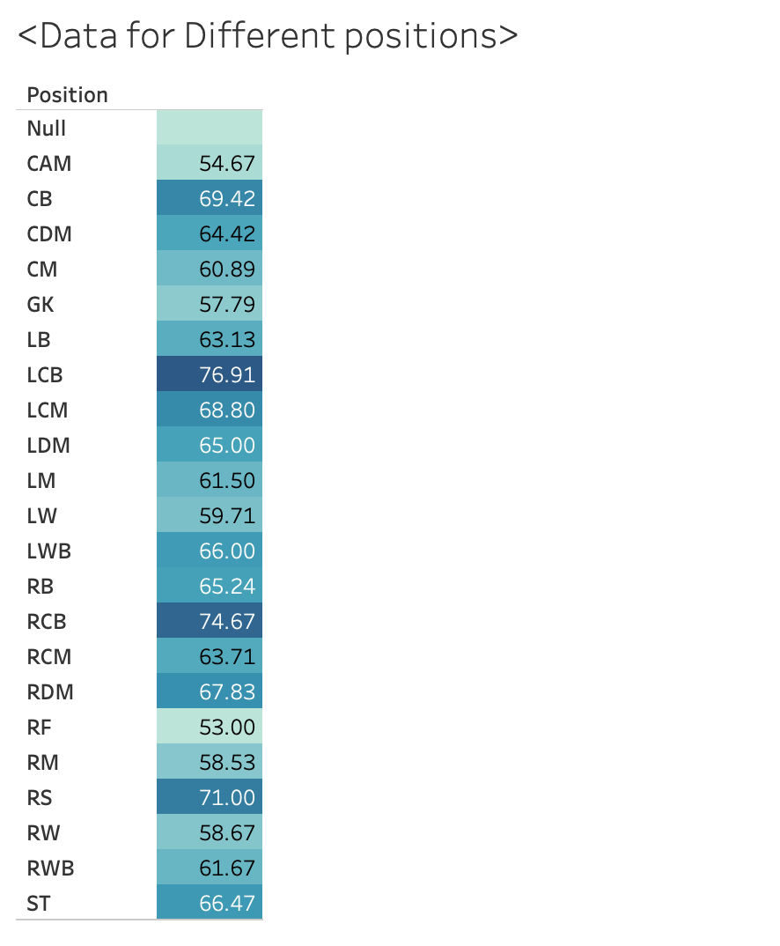
Data View

Slide 4

Thank you for visiting and we would like to see you next time!
Logout Here

